Slide 1

Netflix Subscription Database
Group K(Himani Porwal, Claire Holman, Mehak Gupta, Anubhav Dubey) December 16th, 2023

Slide 2
Project Overview
We aim to discover the relational significance between the movie and TV streaming service with Netflix and its current subscribers.
The analysis will be based on a provided database containing information about customers, plans, content, profiles, payments, devices, usage data and more.
We used mock data to perform our analysis on customer behavior, content popularity, and plan effectiveness.
Through our analysis we aim to discover ways to grow Netflix’s subscribers and create efficiencies in their workflow.
Our assumptions are as follows:
Every payment method should have mandatory one customer but a customer can have multiple saved cards for payments.
Payments are made only in USD.
It is assumed that the runtime for a content is the total time a content is watched, repeated visits to the same content is not taken in consideration.
Notes:
AD

Slide 3
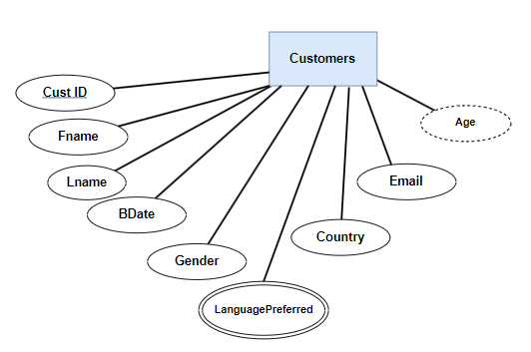
Customers
Customers ( CustID, FName, LName, BDate, Gender, LanguagePreferred, Country, Email )
CustID | FName | LName | BDate | Gender | Country | Email
C1 | Jane | Porter | 1990-02-17 | M | US | jane27@colorado.edu
C2 | Hank | Smith | 1984-03-20 | F | US | hank34@icloud.com
C3 | Bill | Dobbs | 2001-04-17 | M | US | bill71@gmail.com
C4 | Sandy | Peters | 1994-03-10 | F | US | sandy21@mac.com
C5 | Josh | Jacobs | 1975-11-15 | F | US | josh35@aol.com
C6 | Tim | Allen | 2001-03-21 | M | US | allen34@gmail.com
Notes:
MG

Slide 4
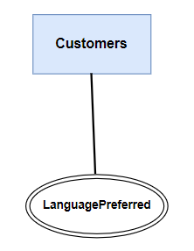
CustomersLanguagePreferred
CustomersLanguagePreferred (Language , CustID [FK])
CustID [FK] | Language
C1 | English
C2 | French
C3 | Spanish
C4 | Japanese
C5 | Korean

Slide 5
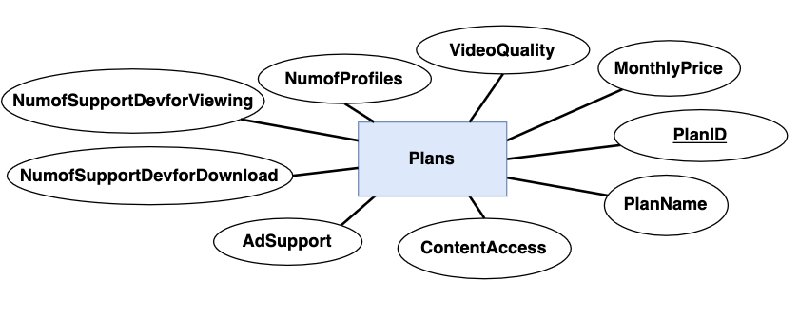
Plans
Plans (PlanID, PlanName, MonthlyPrice, AdSupport, NumOfProfiles, VideoQuality, ContentAccess, NumOfSupportDevForView, NumOfSupportDevForDownload)
PlanID | PlanName | MonthlyPrice | AdSupport | NumOfProfiles | VideoQuality | ContentAccess | NumOfSupportDevForView | NumOfSupportDevForDownload
P1 | Standard w/ Ads | 6.99 | Yes | 1 | Full HD | limited | 2 | 0
P2 | Standard | 15.49 | No | 2 | Full HD | unlimited | 2 | 2
P3 | Premium | 22.99 | No | 4 | Ultra HD | unlimited | 4 | 6
Notes:
MG

Slide 6
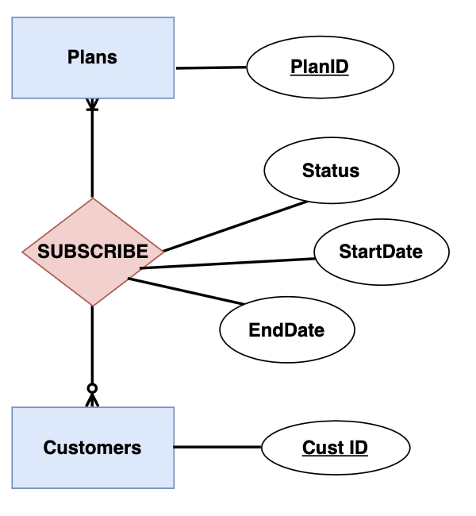
Subscribe
Subscribe(StartDate, CustID [FK], PlanID [FK], Status, EndDate)
StartDate | CustID [FK] | PlanID [FK] | Status | EndDate
2021-08-16 | C1 | P1 | Active | Null
2022-11-26 | C2 | P3 | Inactive | 2023-08-14
2019-10-08 | C3 | P1 | Inactive | 2020-11-06
2021-06-22 | C4 | P2 | Active | Null
2023-01-01 | C5 | P3 | Active | Null
2020-11-06 | C3 | P2 | Active | Null
Notes:
MG

Slide 7
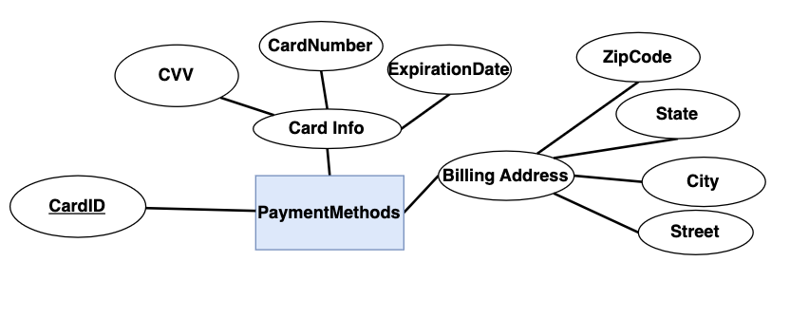
PaymentMethod
PaymentMethod(CardID, CVV, ExpirationDate, CardNumber, ZipCode, State, City, Street, CustID[FK])
CardID | CVV | ExpirationDate | CardNumber | ZipCode | State | City | Street | CustID[FK]
CP2645 | 3xx | 2028-04-23 | xxxx-xxxx-6372 | 80023 | Colorado | Denver | 2755 Olive Street | C1
CP3847 | 6xx | 2030-09-02 | xxxx-xxxx-7845 | 89954 | Colorado | Boulder | 147 Pearl Street | C2
CP7489 | 8xx | 2024-02-17 | xxxx-xxxx-1234 | 78521 | Texas | Austin | 130 Lyndhurst st | C3
CP0346 | 7xx | 2026-12-28 | xxxx-xxxx-7777 | 82001 | Wyoming | Cody | 567 Fox Street | C4
CP1280 | 9xx | 2025-06-07 | xxxx-xxxx-5643 | 84404 | Utah | Moab | 789 Drake Street | C5
Notes:
MG

Slide 8
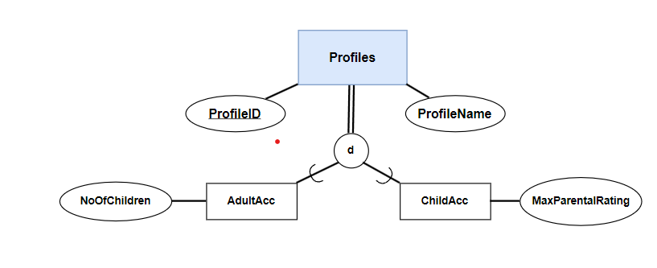
Profile
ProfileID | ProfileName | CustID [FK]
A01C1 | John | C1
A01C2 | Boney | C2
B01C2 | Jennie | C2
C01C2 | Peter | C2
D01C2 | Harsh | C2
A01C3 | Pretty | C3
A01C4 | Ben | C4
B01C4 | Sally | C4
A01C5 | Pinky | C5
B01C5 | Sophia | C5
C01C5 | Jane | C5
D01C5 | James | C5
A02C3 | Billy | C3
B02C3 | Max | C3
Profile (ProfileID, ProfileName, CustID [FK])
Notes:
MG

Slide 9
AdultAcc
ChildAcc
AdultAcc (ProfileID [FK] , NoOfChildren)
ChildAcc (ProfileID [FK] , MaxParentalRating)
ProfileID [FK] | NoOfChildren
AO1C1 | 2
BO1C2 | 1
AO1C3 | 2
DO1C5 | 0
ProfileID [FK] | MaxParentalRating
AO1C2 | TV-Y7
AO1C4 | G
CO1C5 | PG-13
BO2C3 | R

Slide 10
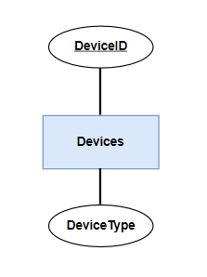
Devices
Devices ( DeviceID, DeviceType)
DeviceID | DeviceType
D0T001 | Tablet
D0V001 | Smart TV
D0M001 | Mobile
D0L001 | Laptop
Notes:
MG

Slide 11
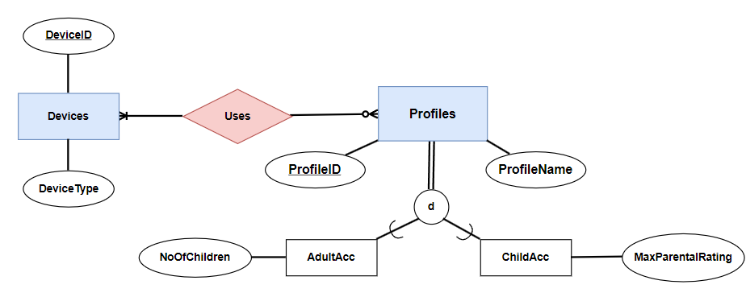
Uses
Uses ( DeviceID [FK] , ProfileID [FK] )
DeviceID [FK] | ProfileID [FK]
D0T001 | A01C1
D0V001 | A01C1
D0M001 | B01C2
D0L001 | C01C2

Slide 12
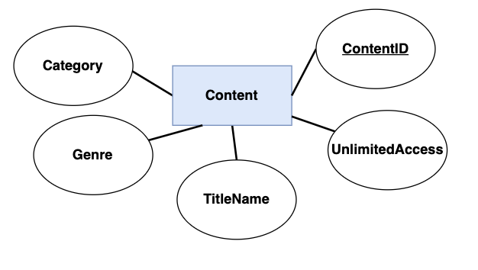
Content
ContentID | Genre | TitleName | Category | UnlimitedAccess
Con1 | Horror | Conjuring | Movie | Yes
Con2 | Action | Extraction | Movie | Yes
Con3 | Romantic | Titanic | Movie | No
Con4 | Comedy | Friends | TV Show | Yes
Con5 | Action | Spider-Man | Movie | Yes
Con6 | Action | Hulk | Movie | No
Con7 | Crime | Catch me if you can | Movie | Yes
Con8 | Crime | Money Heist | TV Show | Yes
Content (ContentID, Genre, TitleName, Category, UnlimitedAccess)
Notes:
MG

Slide 13
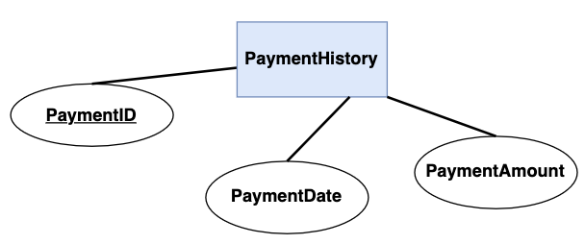
PaymentHistory
PaymentHistory(PaymentID, PaymentDate, PaymentAmount, CardID [FK])
PaymentID | PaymentDate | PaymentAmount | CardID[FK]
INV156 | 2023-11-16 | 6.99 | CP2645
INV478 | 2023-11-26 | 22.99 | CP3847
INV567 | 2023-11-08 | 15.49 | CP7489
INV098 | 2023-11-22 | 15.49 | CP0346
INV234 | 2023-11-01 | 22.99 | CP1280
Notes:
MG

Slide 14
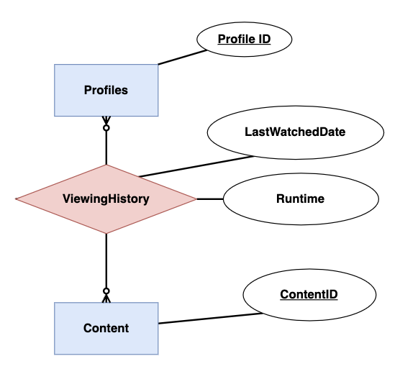
ViewingHistory
ContentID [FK] | ProfileID [FK] | LastWatchedDate | Runtime (mins)
Con1 | A01C5 | 2023-11-01 | 20
Con2 | A01C5 | 2023-10-08 | 16
Con3 | A01C5 | 2023-10-20 | 35
Con4 | A01C5 | 2023-08-01 | 47
Con5 | A01C5 | 2023-01-19 | 29
Con3 | B01C5 | 2023-11-01 | 46
Con5 | B01C5 | 2023-10-08 | 10
Con6 | B01C5 | 2023-10-20 | 13
Con8 | B01C5 | 2023-08-01 | 18
Con1 | C01C5 | 2023-01-19 | 30
Con3 | C01C5 | 2023-11-01 | 26
Con5 | C01C5 | 2023-10-08 | 29
Con7 | D01C5 | 2023-10-20 | 31
Con8 | D01C5 | 2023-08-01 | 42
Con2 | A01C1 | 2023-01-19 | 28
ViewingHistory(ContentID [FK], ProfileID [FK], LastWatchedDate, Runtime)
Notes:
MG

Slide 15
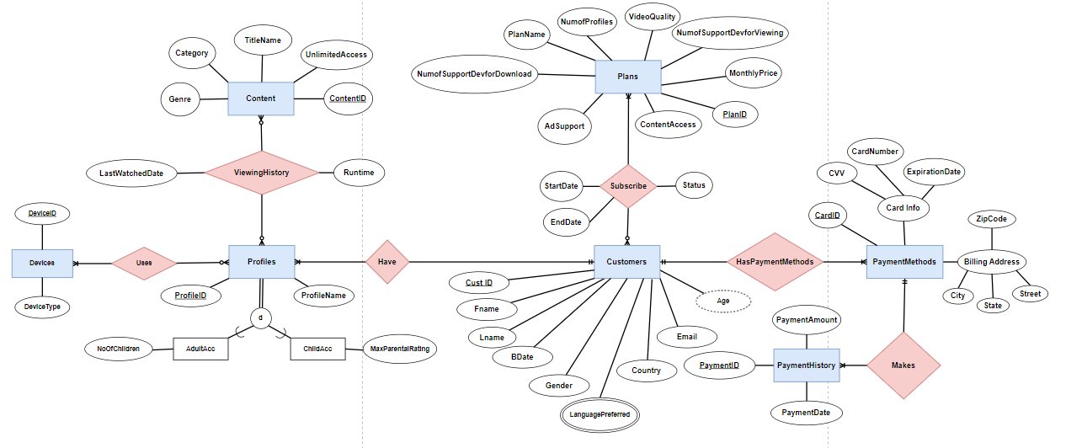
Netflix Database Full ERD
Notes:
HP

Slide 16
Business Insights from Netflix Database

Slide 17
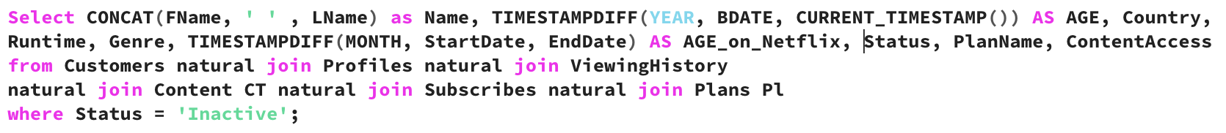
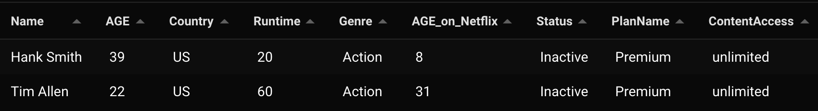
1. Customer Churn
This business implications gives us the customers churn based on their age, viewing pattern(content they preferred watching), demographics, age on Netflix and the subscribed plans. If this number goes high then it alarms that new measure should be implemented for customer retention.
Himani Porwal
Notes:
HP

Slide 18
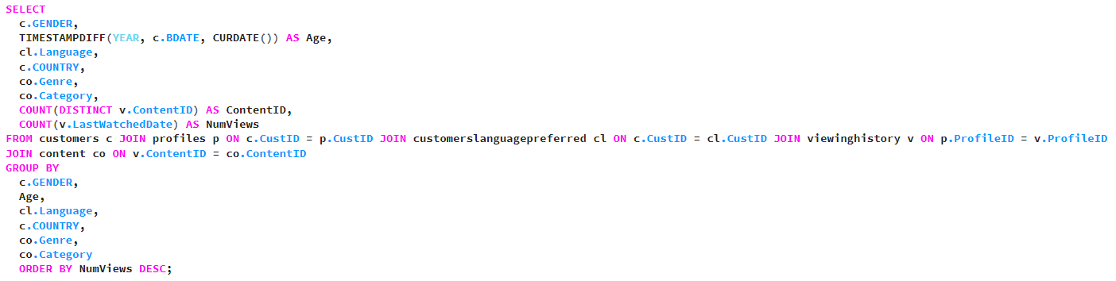
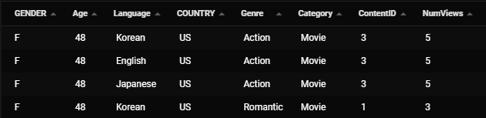
2. Content Preference Analysis
Anubhav Dubey
Notes:
AD

Slide 19
This query provides valuable insights into the viewing habits of Netflix users across various demographics and content categories. Here are some key business implications:
Gender: We can analyze how viewing behavior differs between genders. For example, which genres are more popular among men vs. women? This information can be used to tailor content recommendations and marketing campaigns to specific demographics.
Age: By analyzing viewing habits by age group, Netflix can understand what content resonates with different audiences. This can help them develop targeted content strategies and acquire content licenses that cater to specific age groups.
Language: Understanding which languages are most popular among viewers can help Netflix decide which languages to prioritize for subtitles and dubbing. This can make their content accessible to a wider audience and potentially increase viewership.
Country: Analyzing viewing habits by country can reveal cultural preferences and identify opportunities for international expansion. Netflix can use this information to tailor their content offerings and marketing strategies to different regions.
Genre: By analyzing how many views each genre receives, Netflix can identify which genres are most popular and focus on acquiring or producing content in those genres. This can help them attract and retain subscribers.
Category: Analyzing viewing habits by category (e.g., movies, TV shows, documentaries) can help Netflix understand how viewers are using their platform. This information can be used to optimize the user experience and prioritize different types of content.
Anubhav Dubey
Notes:
AD

Slide 20
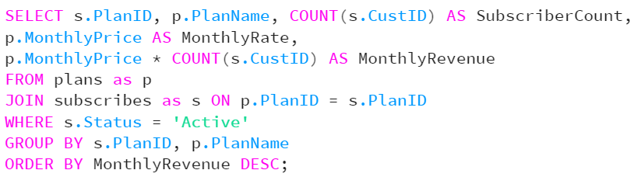
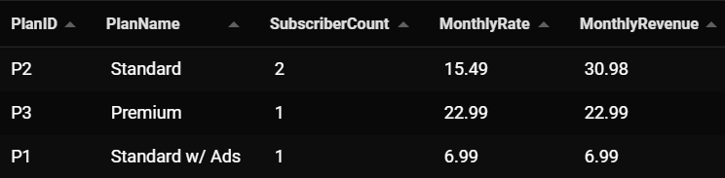
3. Optimizing Revenue through Subscription Plans
This helps us understand which plans are most popular, the associated payment history and customer retention. This can guide decisions on pricing strategies and the introduction of new plans.
Mehak Gupta
Notes:
MG

Slide 21
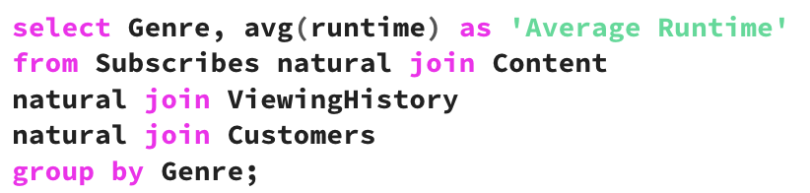
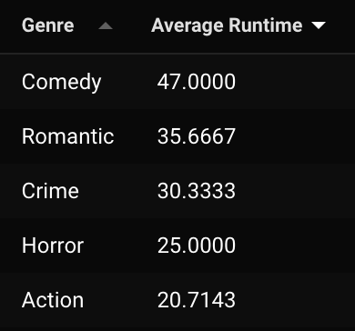
4. Customers average runtime based on movie genres
Show customers average runtime (2 decimals) for movie genres.
The business implications of this information is showing us what type of movies are customers spending the most time on. This can give us insights into how to have sufficient movie genres on our platform.
Claire Holman
Notes:
CH

Slide 22
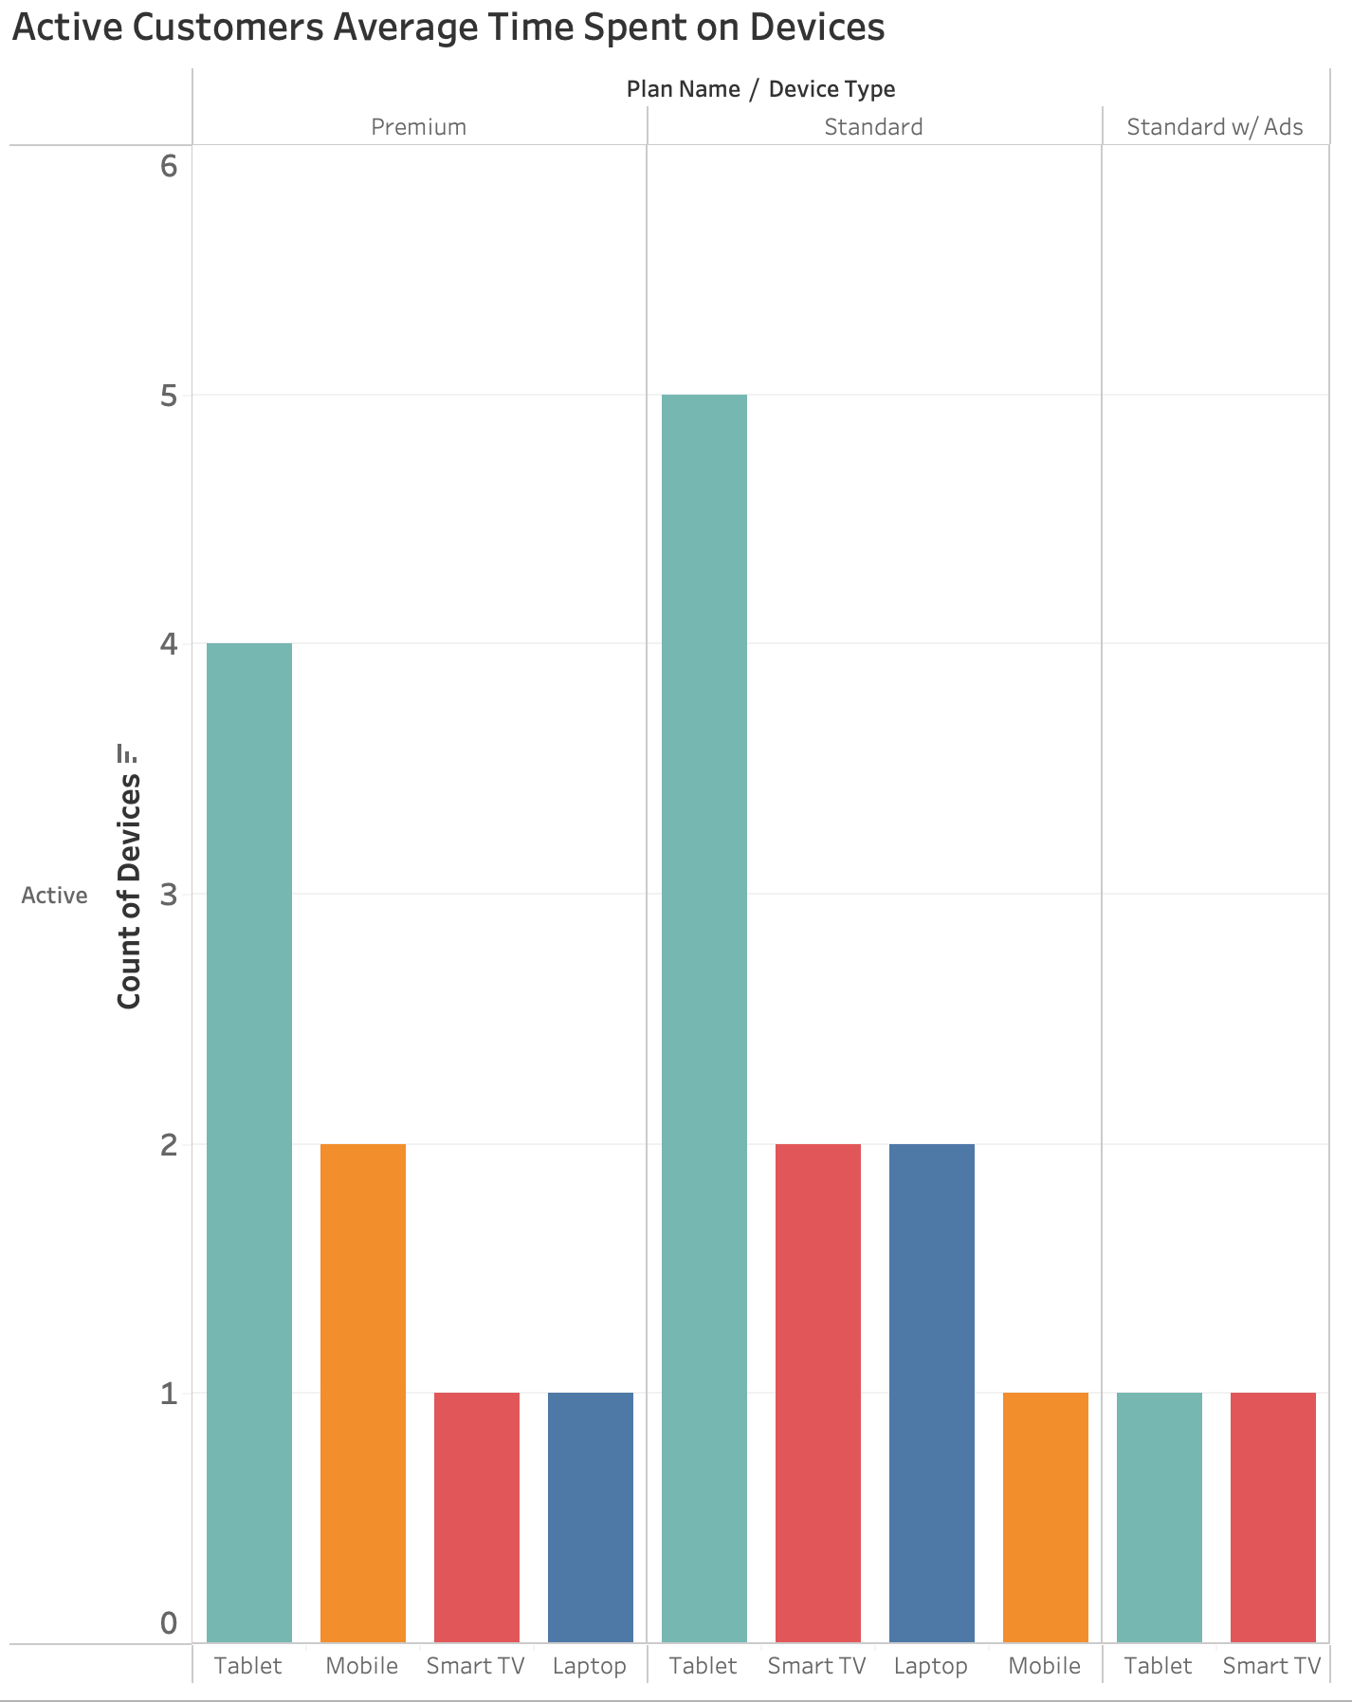
Data Visualization
Active customers average time spend on devices based on their current plan
Business Implications: helps Netflix model their subscription plans and see what platform customers spend most of their time
Notes:
CH- This information can help Netflix’s model there recent restriction on who/ how many can use a Netflix subscription account. For instance, with this example, they could restrict how many Tablets can use Nexflix’s Standard subscription in a way to force users to upgrade their subscription.

Slide 23
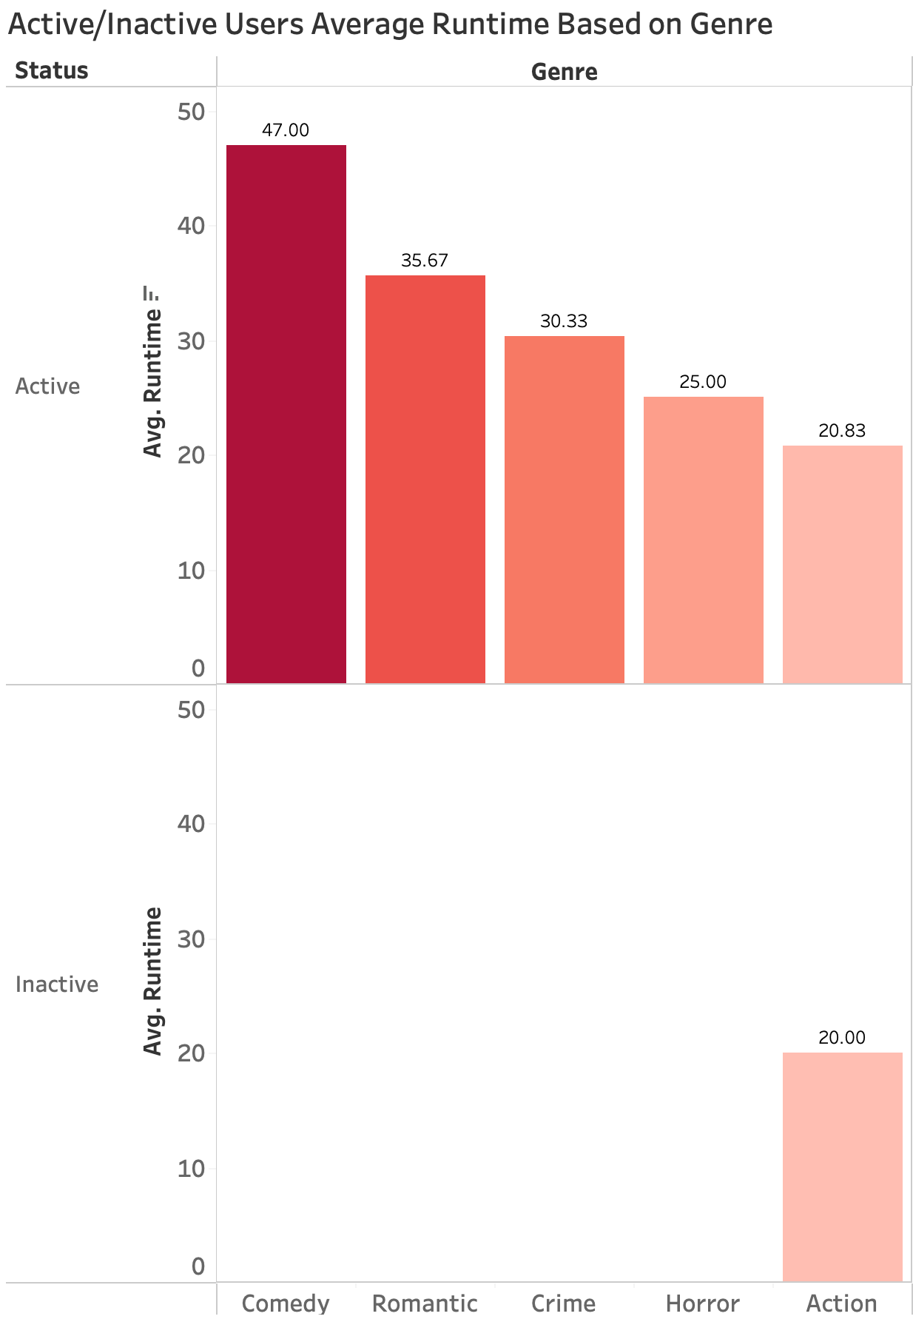
Data Visualization
Genre preference based on runtime for active/inactive customers
Business Implications: User’s preferences, for inactive understand why they would leave, catering more content to their preferences.
Notes:
CH- Insure customer retention

Slide 24
Lessons Learned
We learned there are many assumptions which needs to be made during database designing.
When we reached the business insights part, we discovered that even small dataset can give useful information to make decisions.
We learned that how a project is done from start to finish like from design to usage stage.
Notes:
CH

Slide 25
THANK YOU

